Slide 1


Visualizing and forecasting of stock data
THE WEB APPLICATION
Guide name: arushi gupta
Team member name
.suhail kassar
.piyush gupta
.manan sharma
Department: computer science

Slide 2
Stock investments provide one of the highest returns in the market. Even though they are volatile in nature, one can visualize share prices and other statistical factors which helps the keen investors carefully decide on which company they want to spend their earnings on.
introduction

Slide 3
Problem statement
As we can not access properly the company information like logo of the company registered name and description and stock plots based on stock code and It is difficult to find out the upcoming prices for the user.

Slide 4

Research objective
Stock investments provide one of the highest returns in the market. Even though they are volatile in nature, one can visualize share prices and other statistical factors which helps the keen investors carefully decide on which company they want to spend their earnings on.

Slide 5

About the Project
we make a web application
creating a single-page web application using Dash (a python framework) and some machine learning models
which will show company information (logo, registered name and description) and stock plots based on the stock code given by the user.
Also the ML model will enable the user to get predicted stock prices for the date inputted by the user.
visualise and forecast the stock data

Slide 6
methodology
01
02
03
input stack code to get company information
select date range to get stock price and estimated moving average plots
input number of days to get forecast

Slide 7
using dash (python framework)
01
technology used in this project
02
stylling with css
using some machine learning module
03

Slide 8
Flow chart
Planning and approval
Phase 1
Phase 4
Phase 2
Project Life Cycle
project outcome
Research and work on project
Phase 3
launch the web application

Slide 9
project outcome
After finishing the project we should have a complete project where user input - stock, code can give us the company information and relevant plots. Also, user input number of days can give us a forecast plot.

Slide 10
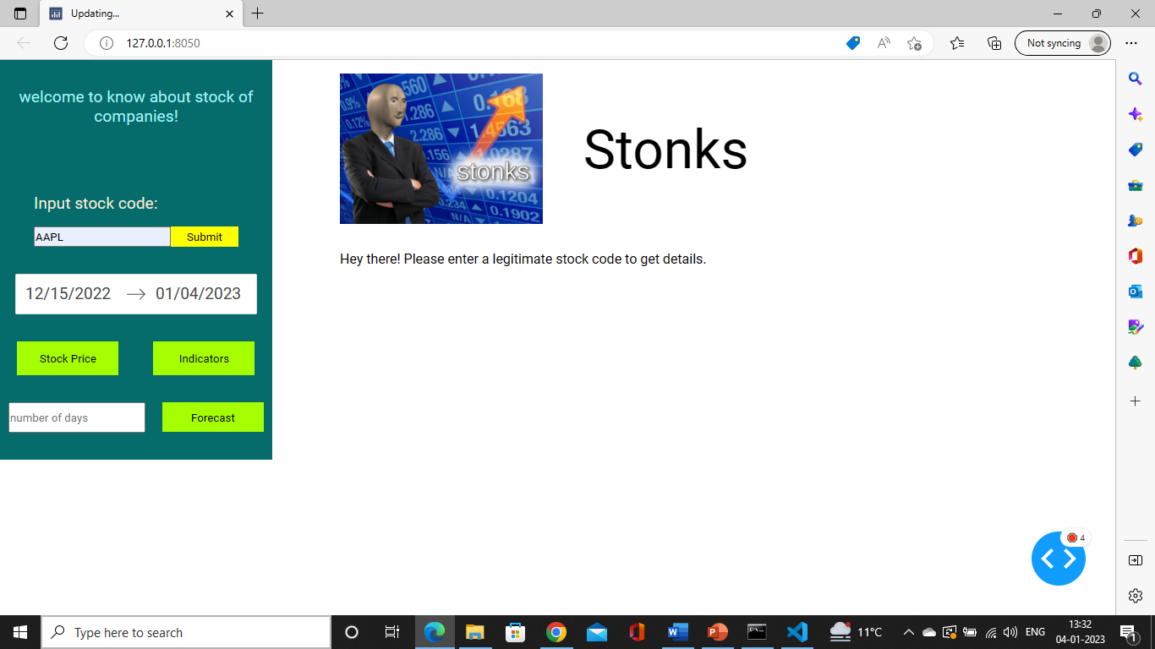

Slide 11
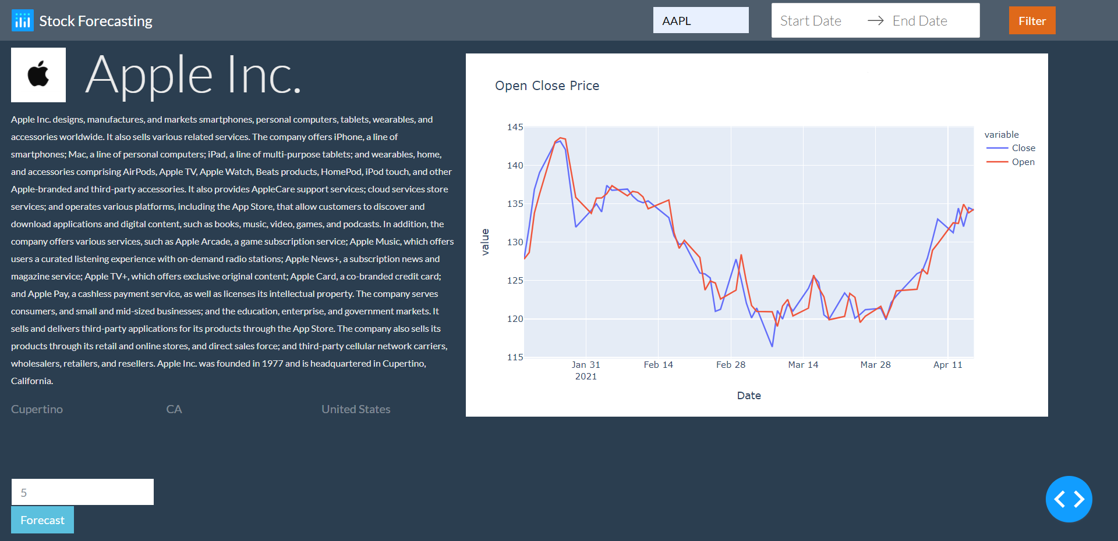

Slide 12

Thank you!
for giving your precious time

